Slide 1
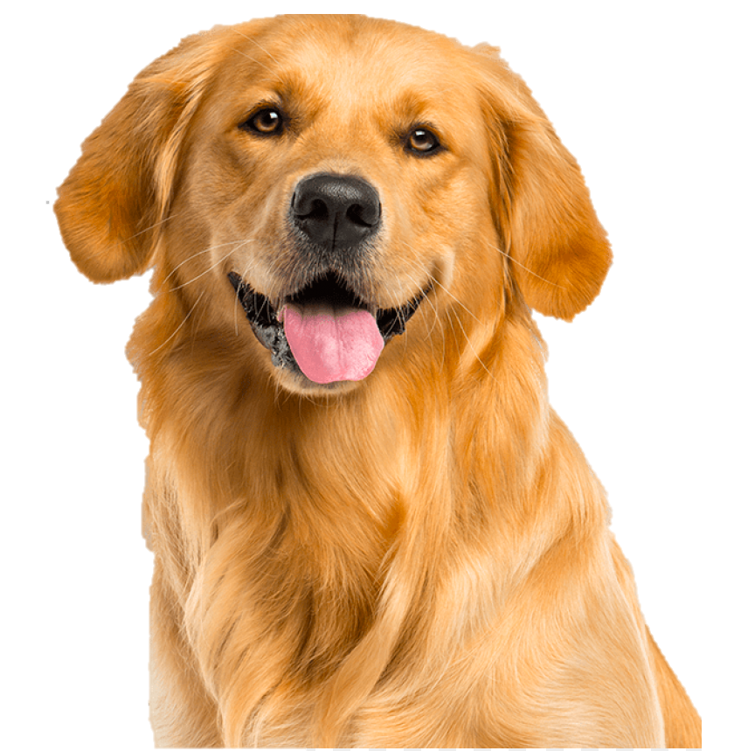
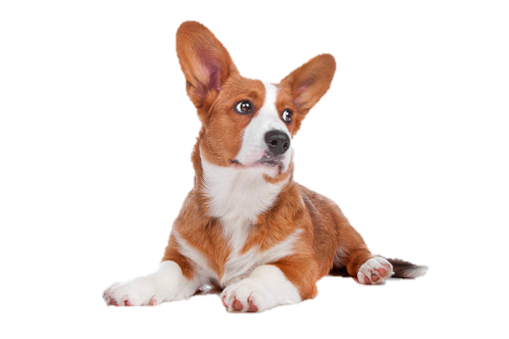
Module 1 CLI Application
Furry Finder
by Brandon Brown

Slide 2
What did I struggle with?
I spent a considerable amount of time troubleshooting objects that did not seem to update when joining table entries were added. The solution for this was to reload the object using the .find_by ActiveRecord method. (i.e. LoggedInUser.user = User.find_by(id: LoggedInUser.user.id)
Designing a reliable CLI menu system proved more of a challenge than expected. After thinking about it extensively and defining the menu loop logic, I am glad to say I have developed a robust menu system for this application.

Slide 3
What did I learn?
I became much more familiar with ActiveRecord including how to manage has-many-through and has-many-belongs-to relationships.
I learned multiple gems that improved CLI user interaction including TTY-Prompt, TTY-Fonts, and TTY-Table.
I developed much greater skills with Ruby enumerable methods including each, select, find, and map.

Slide 4
What would I change or add?
I would like to add a messaging portion to this application where an adopter could message a foster parent to talk about dog adoptions.
I would like to incorporate location into the dog matching algorithm. This way, results would be biased based on how close the dog was to the potential adopter.

Slide 5
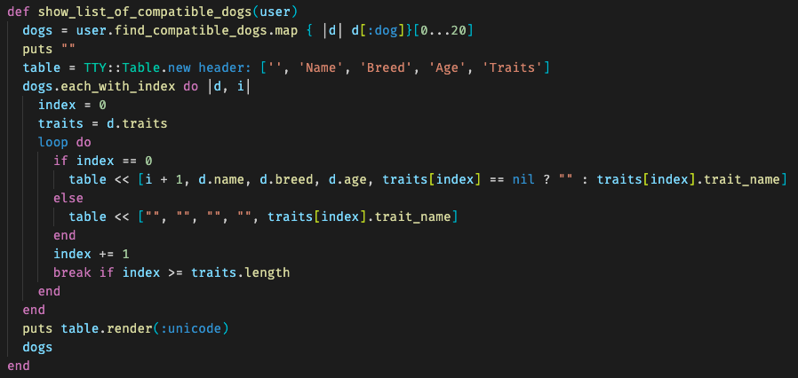
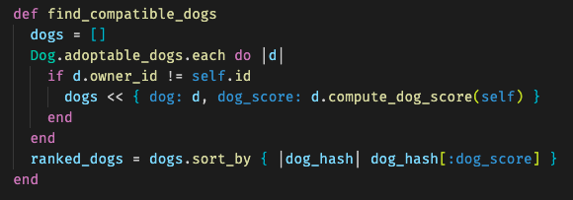
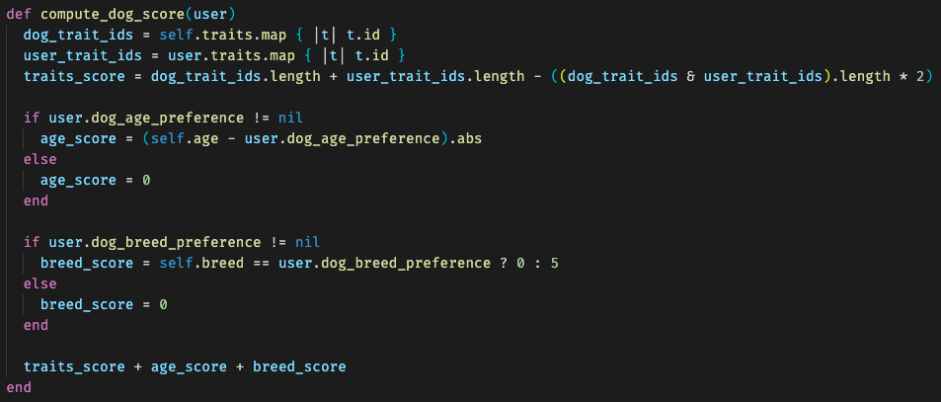
Code I Would Like to Highlight
1
2
3
I was most proud of these three snippets of code.
The first is the creation of a table using the TTY-Table gem. This table was used to show all compatible dogs.
The second collects compatible dogs into a hash and ranks them based on their computed score.
The third returns the dogs’ scores based on how similar they are to the adopter searching for dogs (lower is better).

